Slide 2
LAYERS IN NEURAL NETWORK
The input layer:
Introduces input values into the network.
No activation function or other processing.
The hidden layer(s):
Performs classification of features.
Two hidden layers are sufficient to solve any problem.
Features imply more layers may be better.
The output layer:
Functionally is just like the hidden layers.
Outputs are passed on to the world outside the neural network.

Slide 3
MULTILAYER FEEDFORWARD NETWORK
Inputs
Hiddens
I₀
Outputs
h₀
I₁
o₀
h₁
I₂
o₁
h₂
Outputs
I₃
Hiddens
Inputs

Slide 4
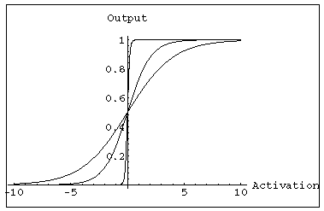
MULTILAYER FEEDFORWARD NETWORK:
ACTIVATION AND TRAINING
For feed forward networks:
A continuous function can be differentiated allowing gradient-descent.
Back propagation is an example of a gradient-descent technique.
Uses sigmoid (binary or bipolar) activation function.

Slide 5
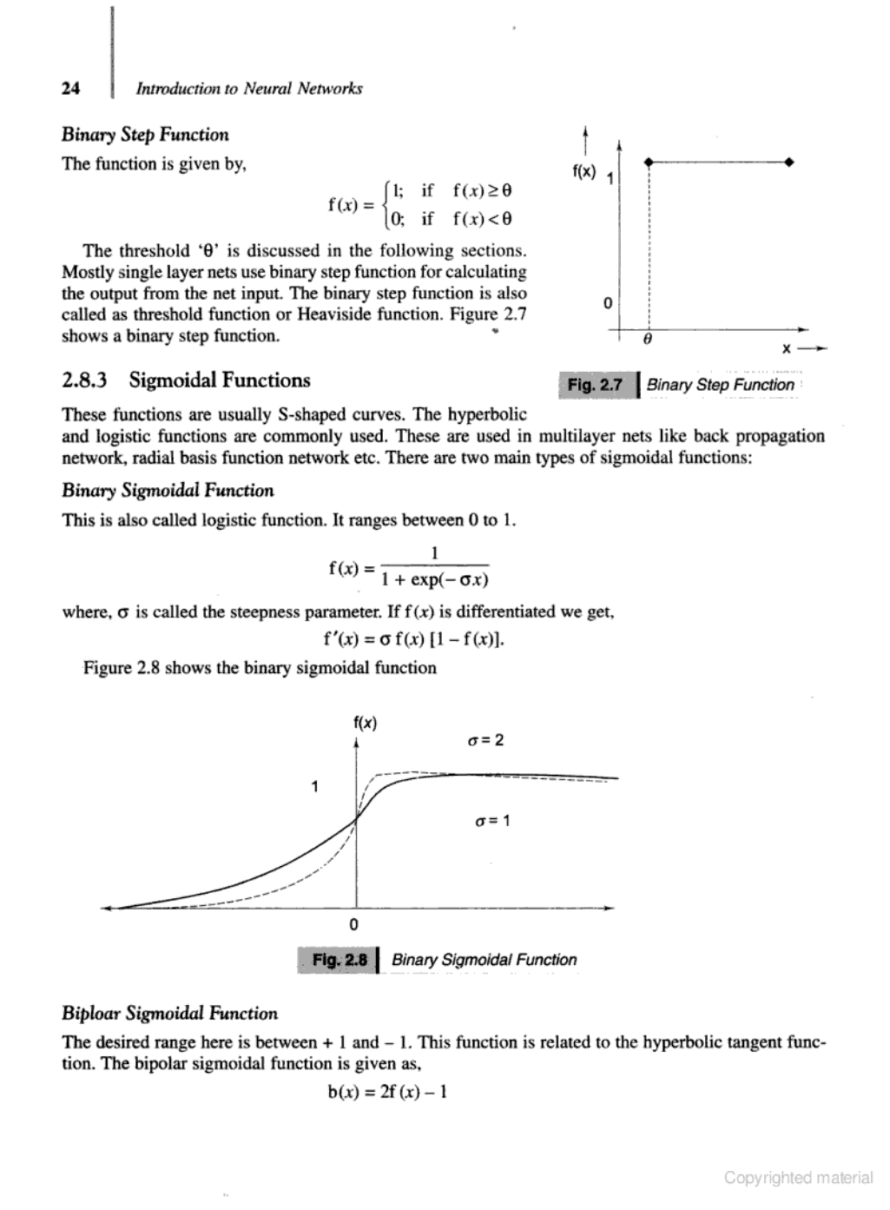
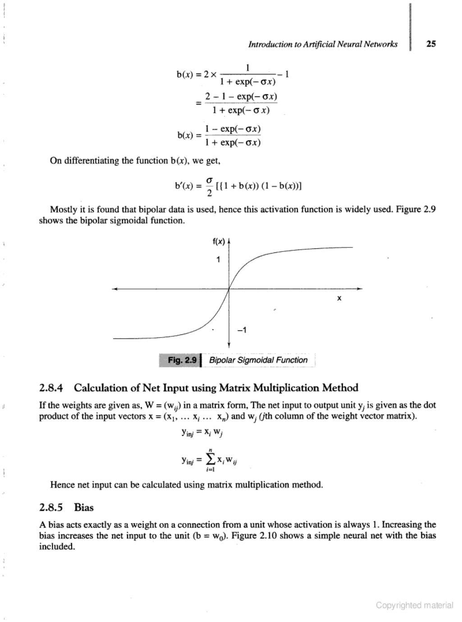
In multilayer networks, the activation function is usually more complex than just a threshold function, like 1/[1+exp(-x)] or even 2/[1+exp(-x)] – 1, etc.
Binary Sigmoidal Function
Bipolar Sigmoidal Function

Slide 6
In multilayer networks, the activation function is usually more complex than just a threshold function, like 1/[1+exp(-x)] or even 2/[1+exp(-x)] – 1, etc.
Binary Sigmoidal Function
Bipolar Sigmoidal Function

Slide 7
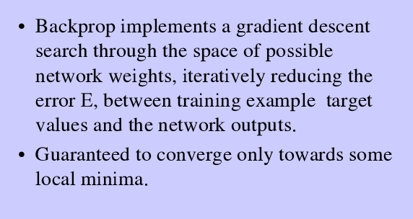
BACK PROPAGATION NETWORK

Slide 8
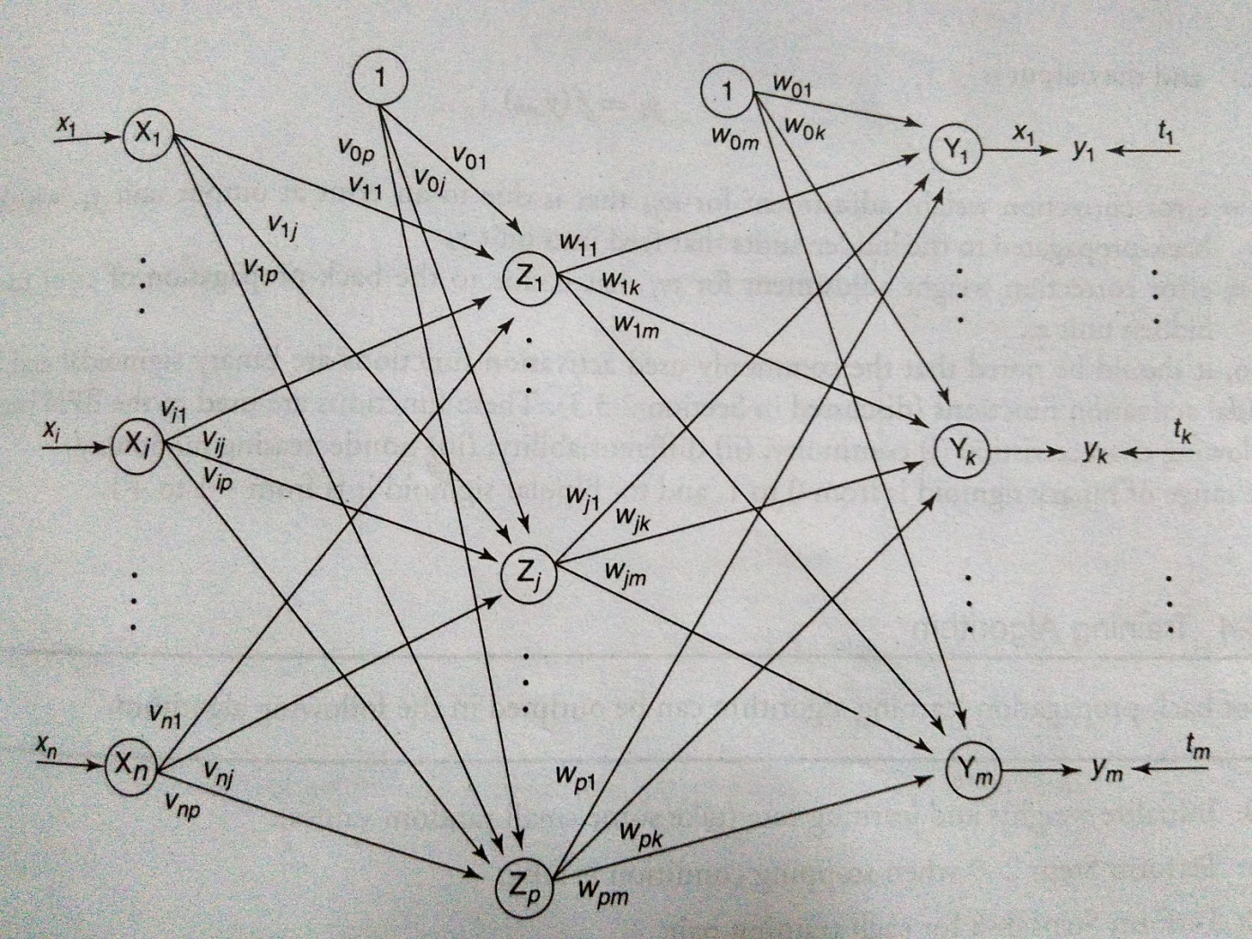
A training procedure which allows multilayer feed forward Neural Networks to be trained.
Can theoretically perform “any” input-output mapping.
Can learn to solve linearly inseparable problems.

Slide 9
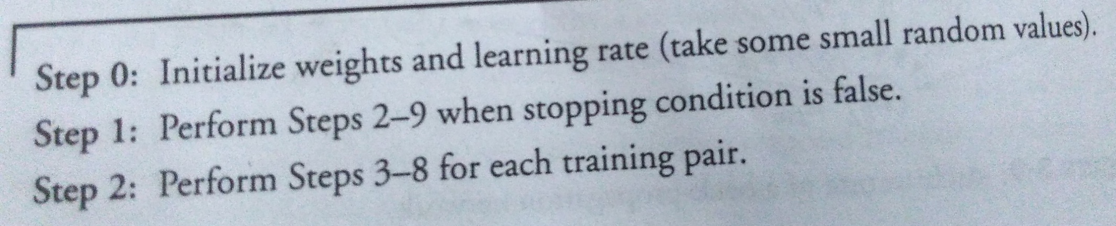
BACKPROPAGATION TRAINING ALGORITHM

Slide 10
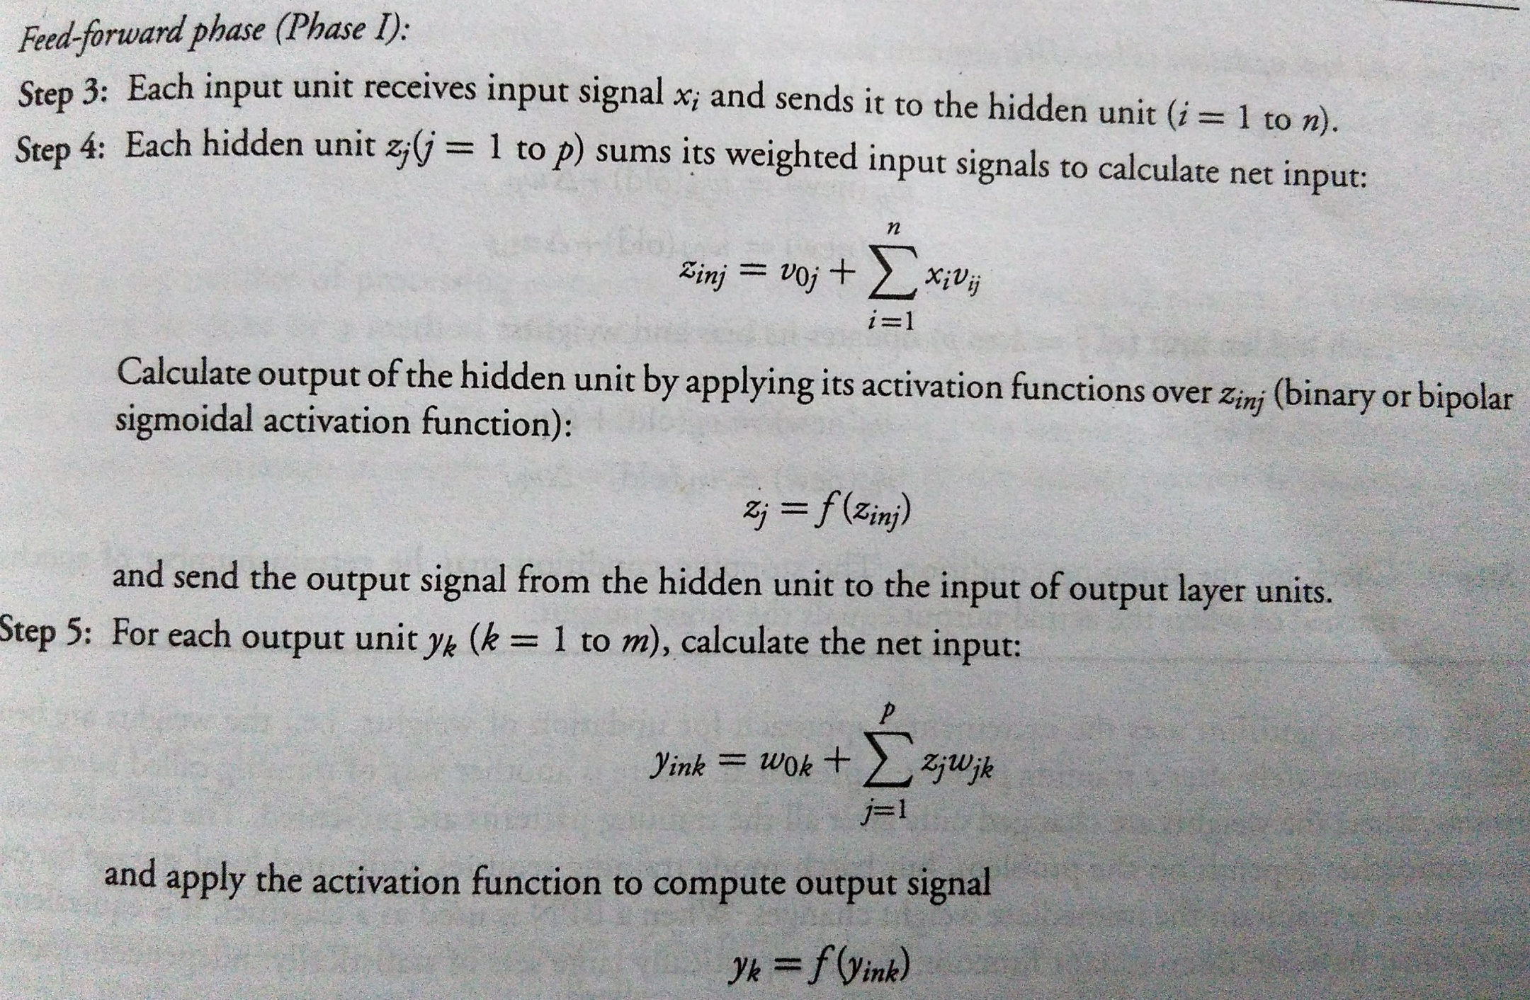
BACKPROPAGATION TRAINING ALGORITHM

Slide 11
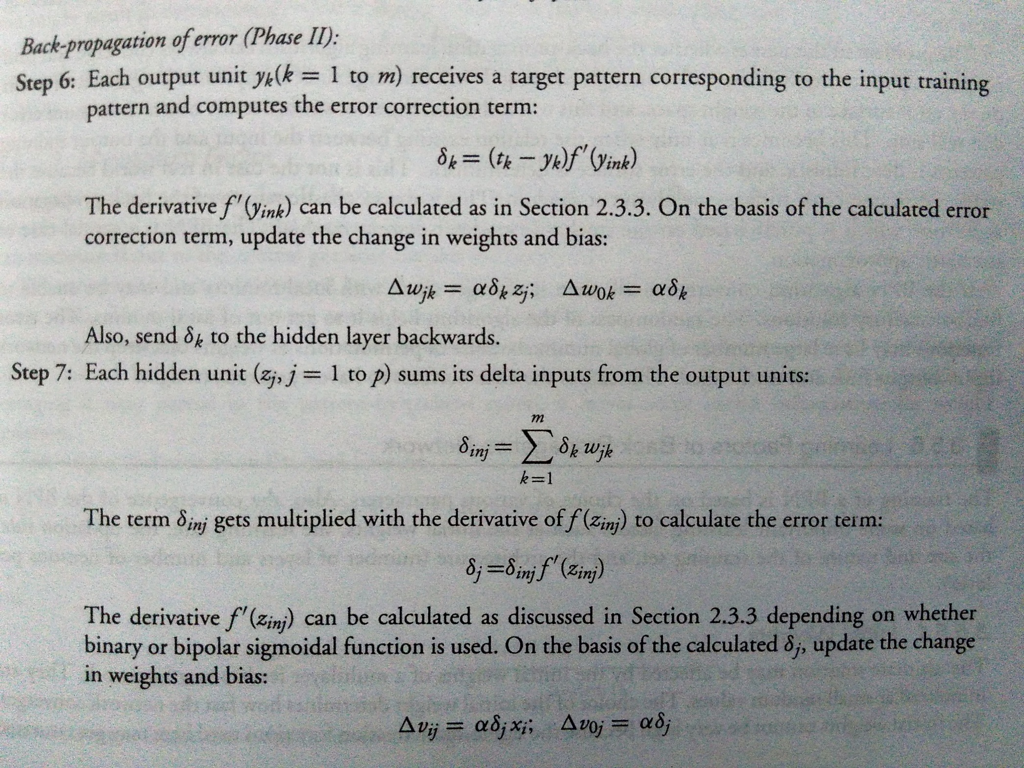
BACKPROPAGATION TRAINING ALGORITHM

Slide 12
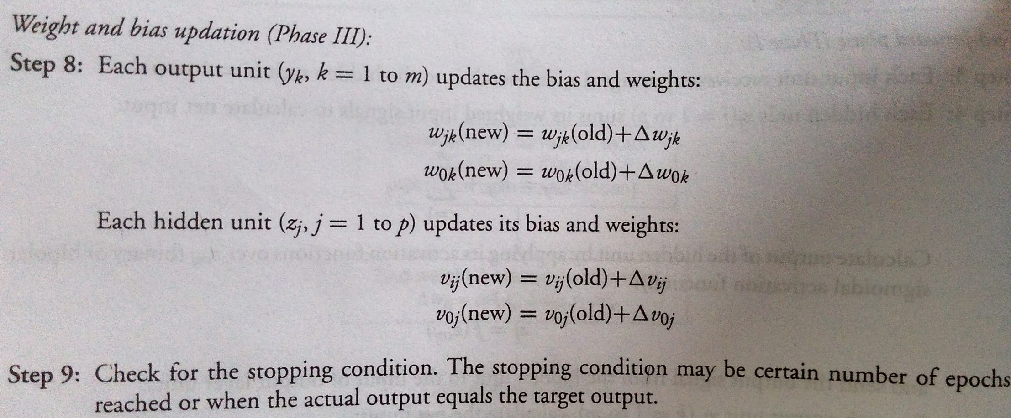
BACKPROPAGATION TRAINING ALGORITHM

Slide 13
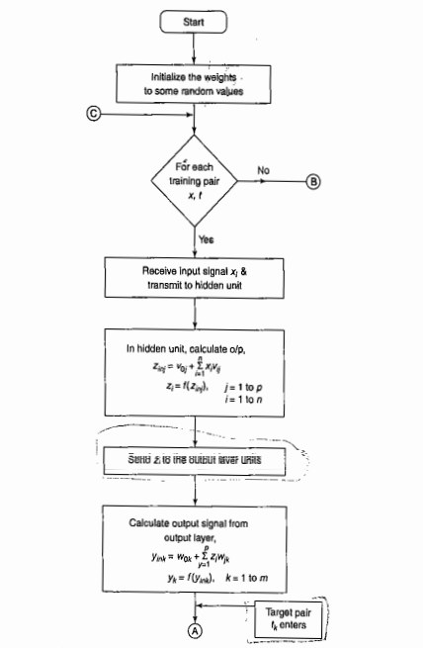

Slide 14
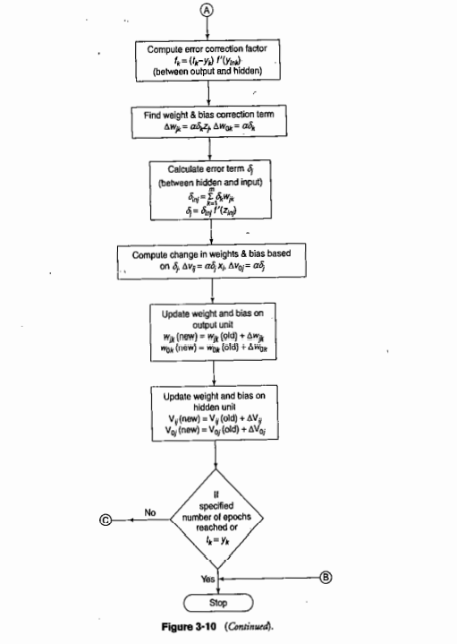

Slide 15
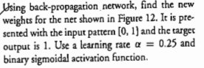
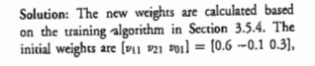
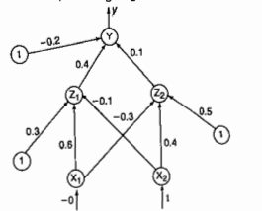
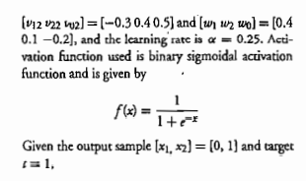

Slide 16
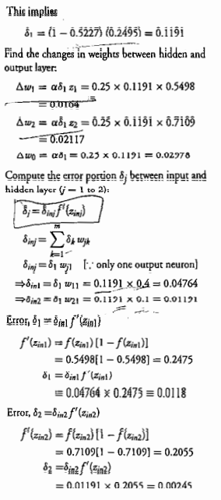
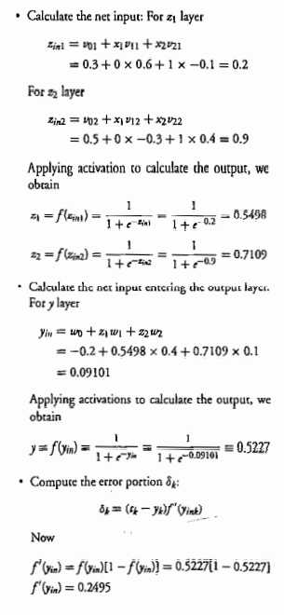

Slide 17
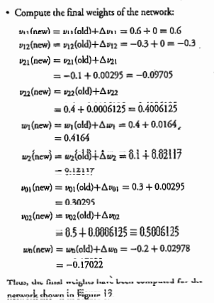
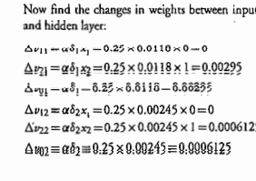
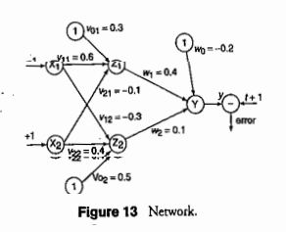

Slide 18
BACKPROPAGATION
Gradient descent over entire network weight vector
Easily generalized to arbitrary directed graphs
Will find a local, not necessarily global error minimum -in practice often works well (can be invoked multiple times with different initial weights)
Often include weight momentum term
Minimizes error training examples
Will it generalize well to unseen instances (over-fitting)?

Slide 19
APPLICATIONS OF BACKPROPAGATION
NETWORK
Load forecasting problems in power systems.
Image processing.
Fault diagnosis and fault detection.
Gesture recognition, speech recognition.
Signature verification.
Bioinformatics.
Structural engineering design (civil).

Slide 20
UNSUPERVISED LEARNING

Slide 21
UNSUPERVISED LEARNING
No help from the outside.
No training data, no information available on the desired output.
Learning by doing.
Used to pick out structure in the input:
Clustering,
Reduction of dimensionality → compression.
Example: Kohonen’s Learning Law.

Slide 22
Self Organizing Maps – Kohonen Maps
It is a type of Artificial Neural Network which is also inspired by biological models of neural systems from the 1970s.
It follows an unsupervised learning approach and trained its network through a competitive learning algorithm.
SOM is used for clustering and mapping (or dimensionality reduction) techniques to map multidimensional data onto lower-dimensional which allows people to reduce complex problems for easy interpretation.

Slide 23
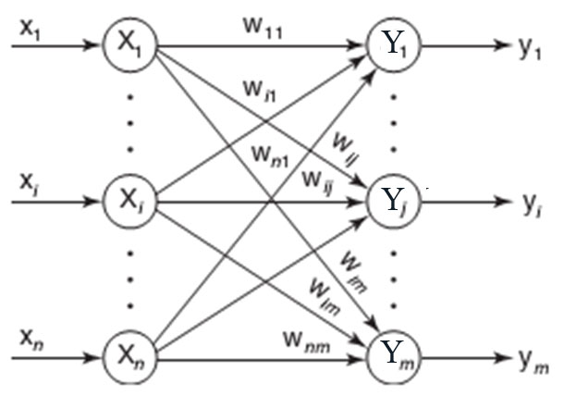
ARCHITECTURE OF KSOFM

Slide 24
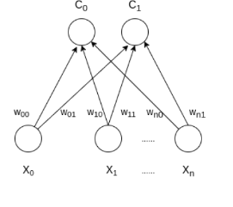
SOM has two layers, one is the Input layer and the other one is the Output layer. The architecture of the Self Organizing Map with two clusters and n input features of any sample is given below:

Slide 25
How it works
Let’s say an input data of size (m, n) where m is the number of training examples and n is the number of features in each example. First, it initializes the weights of size (n, C) where C is the number of clusters. Then iterating over the input data, for each training example, it updates the winning vector (weight vector with the shortest distance (e.g Euclidean distance) from training example). Weight updation rule is given by :

Slide 26
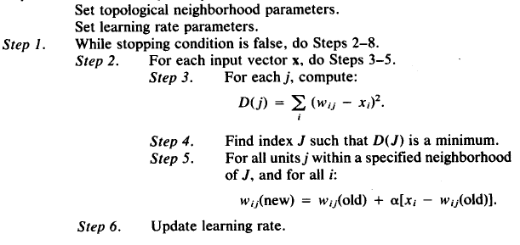
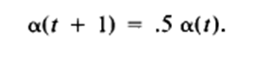
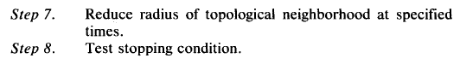
KSOFM ALGORITHM
Step 0. Initialize weights w_{ij} to a small random
values, say in an interval [0, 1].

Slide 27
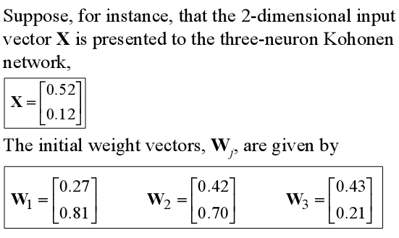
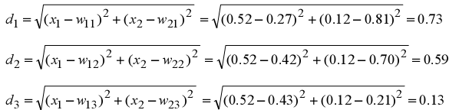
EXAMPLE OF KSOFM
Find the winning neuron using the Euclidean distance:

Slide 28
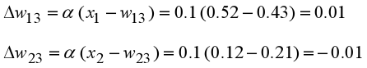
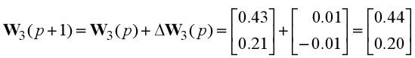
Neuron 3 is the winner and its weight vector W₃ is updated according to the competitive learning rule:
The updated weight vector W3 at iteration (p+1) is determined as:
The weight vector W3 of the winning neuron 3 becomes closer to the input vector X with each iteration.

Slide 29
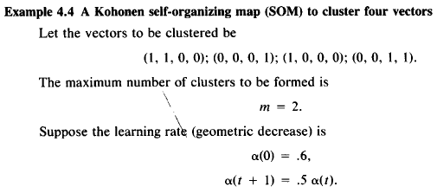
EXAMPLE OF KSOFM

Slide 30
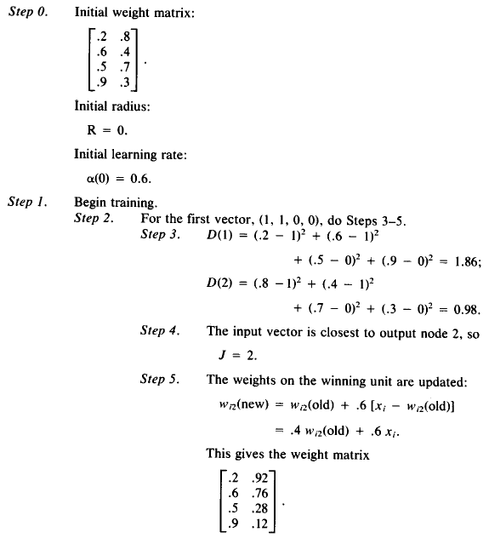

Slide 31
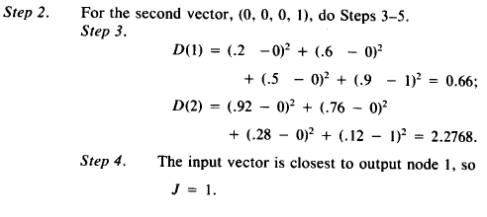
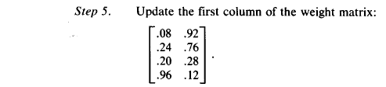

Slide 32
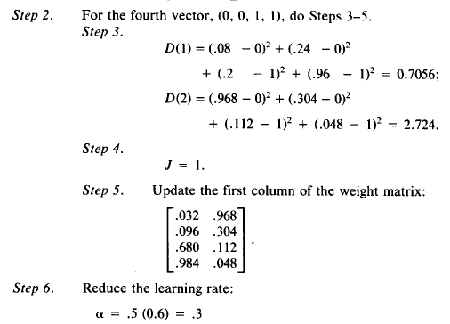

Slide 34
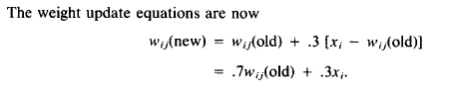
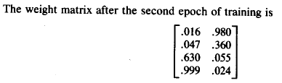
And so on…….

